Slide 1

Zoom
Etiquette
1. If the number of participants allow, we’ll have brief introductions.
2. Mute yourself when not talking so we don’t all hear each other’s background noises.
3. Try not to talk over others (it’s easy to do with this platform)- to assist with this, physically raise your hand if you have your video on, or use the “raise your hand” feature in the chat box.
4. If you have access to the video feature, please turn it on so we can all see one another. Seeing faces really helps strengthen our connection.
Notes:
Prompting words/thoughts:
If teachers are stuck or participation is slow to start ask them what these words mean to them:
Facilitator or guide. Flexibility, communication, collaboration, critical thinking.

Slide 2
Staying
Connected Series Announcements
Keep conversation open and real - let’s plan on this hour to be a sharing of information that is as positive as possible.
We are recording the Staying Connected Series. Each recording will be added to the Early Educator Support Office website.
After this session, we will send out this powerpoint and your completion certificate for one credit hour. For those educators with an SPII license, this can be used toward your required renewal credits
Notes:
Prompting words/thoughts:
If teachers are stuck or participation is slow to start ask them what these words mean to them:
Facilitator or guide. Flexibility, communication, collaboration, critical thinking.

Slide 3

Staying Connected Series: Today and Tomorrow 21st Century Skills
Facilitators:
Kawanna Jackson
Jessica Burris
Cheryo Johnson

Slide 4
What are 21st Century Skills?
Think for a moment about the phrase 21st century skills. What comes to mind when you think of this phrase?

Slide 5
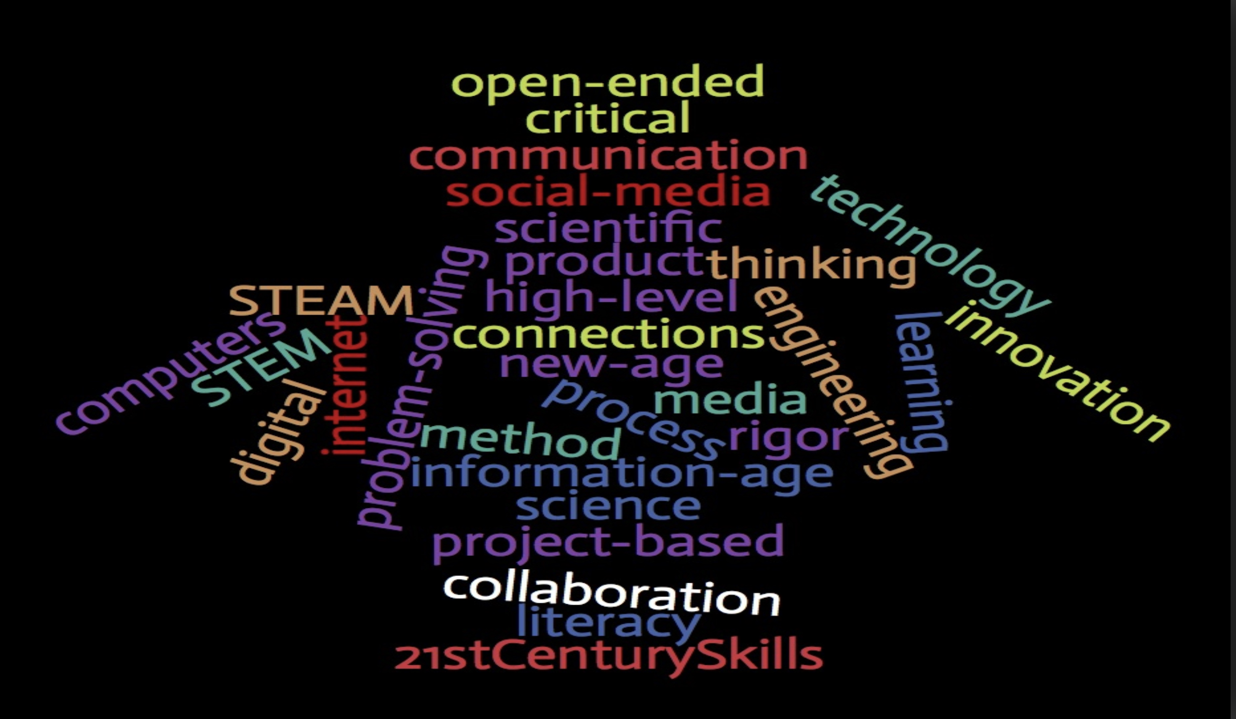

Slide 6
Thoughts About Defining 21st Century Skills
These are some thoughts to consider when defining 21st Century Skills:
Beware of using the term 21st century skills as an all encompassing catch all phrase for using technology for learning.
21st Century learning skills shouldn’t be a term that feels like it’s an era that we are trying to attain…we are living in the 21st century now.
Large amounts of money are being poured into advancing 21st century skills in the classroom and creating curriculums that enhance these skills that it is worth having a clear and concise definition.
There are frameworks, guides and components of 21st century skills that serve as defining 21st century skills could these components be interpreted many ways by teachers?(Mirra, 2017)
What are your thoughts on these ideas surrounding the definition of 21st Century skills?

Slide 7
Definition
•Overall, 21st Century Skills are essential skills and abilities that help learners succeed in life and career in the 21st century.
•More specifically, 21st Century Learning Skills are “a range of important skills that the Partnership for 21st Century Skills identifies as media and technology skills, life and career skills, core subject skills and a collection of learning and innovation skills referred to as the 4cs: creativity, critical thinking, collaboration and communication.” (Wise Linderman and McKendry Anderson, n.d., para. 4)
How would you define 21st century skills for early learners based on the broader definition?
Notes:
Prompting words/thoughts:
If teachers are stuck or participation is slow to start ask them what these words mean to them:
Facilitator or guide. Flexibility, communication, collaboration, critical thinking.

Slide 8
Frameworks and Guides
•The Partnership for 21st Century Learning (P21) has established 21st Century learning framework for early childhood that can be broken down into 3 main skill types….
Literacy Skills
Information Literacy
Media Literacy
Technology Literacy
Learning Skills
Critical Thinking
Creative Thinking
Collaborating
Communicating
Life Skills
Flexibility
Initiative
Social Skills
Productivity
Leadership
(Berry, n.d.)
Notes:
Prompting words/thoughts:
If teachers are stuck or participation is slow to start ask them what these words mean to them:
Facilitator or guide. Flexibility, communication, collaboration, critical thinking.

Slide 9
Frameworks and Guides
•The P21 guide designates 4 primary areas that support integration of 21st Century Learning into early childhood experiences:
•How children learn
•Strategies to help them build learning skills
•Creating the learning environment
•Family Engagement
•(Ross, 2017, para. 5)
Notes:
Prompting words/thoughts:
If teachers are stuck or participation is slow to start ask them what these words mean to them:
Facilitator or guide. Flexibility, communication, collaboration, critical thinking.

Slide 10
Frameworks and Guides
Think about how you may integrate 21st century learning into each of these experiences in Early Childhood Education.
Notes:
Prompting words/thoughts:
If teachers are stuck or participation is slow to start ask them what these words mean to them:
Facilitator or guide. Flexibility, communication, collaboration, critical thinking.

Slide 11

When thinking about 21st century skills, what do you think the role of the teacher is?
(Spatula, N.)
Notes:
Prompting words/thoughts:
If teachers are stuck or participation is slow to start ask them what these words mean to them:
Facilitator or guide. Flexibility, communication, collaboration, critical thinking.

Slide 12
Environment- What does a 21st century classroom look and feel like?
A 21st century classroom can look and feel many different ways, especially if you are following the interests of the children.
What are some ways that you give children ownership in your classroom? How do you facilitate?
What does collaboration look like in your classroom? How do you facilitate?
How do you value or celebrate your children’s creativity?
(Shaw, R.)
Notes:
Take a minute to think about these 3 questions.
Have teachers share ideas. If they are stuck have them think about classroom rules and routines, following children’s interest when it comes to topic of study, open ended art materials, art displayed with dictation…..
A 21st century classroom can look and feel many different ways, especially if you are following the interests of the children. It should be engaging and inviting. It should be a place where children feel like their contributions and ideas matter. Children should feel like they are active members of the classroom where they are free to collaborate, be creative and communicate openly. We are there to guide and facilitate.

Slide 13
Environment- What does a 21st century classroom sound like?
A 21st century classroom can be noisy or quiet. There are many ways to learn and it is a teacher’s job to determine what style best matches the activity, lesson and student needs.
Give an example of a time where your classroom might be very noisy. What are children doing?
Give an example of when it might be best for your classroom to be quiet. What are children doing?
When might your classroom be noisy and quiet? What are children doing?
(Shaw, R.)
Notes:
Allow teachers time to share and discuss.
Example of a noisy classroom: Students are engaged in a science experiment (making predictions, critical thinking skills) or collaborating in the dramatic play center.
Example of a quiet classroom: Students are working in small groups, reading or using technology.
Example of both noise levels: Children are engaged in interest areas. Some are collaborating in a center, working together, some are reading or using technology independently.
Be aware of the noise.
Example of dramatic bus building activity in my K classroom.

Slide 14

Planning for 21st Century Skills
How do you imbed 21st century skills (collaboration, communication, critical thinking and creativity) when planning?
Notes:
Invite teachers to share some ways that they implement these 21st century skills.
“Think about how you may be surprised to know that you are already doing it!

Slide 15
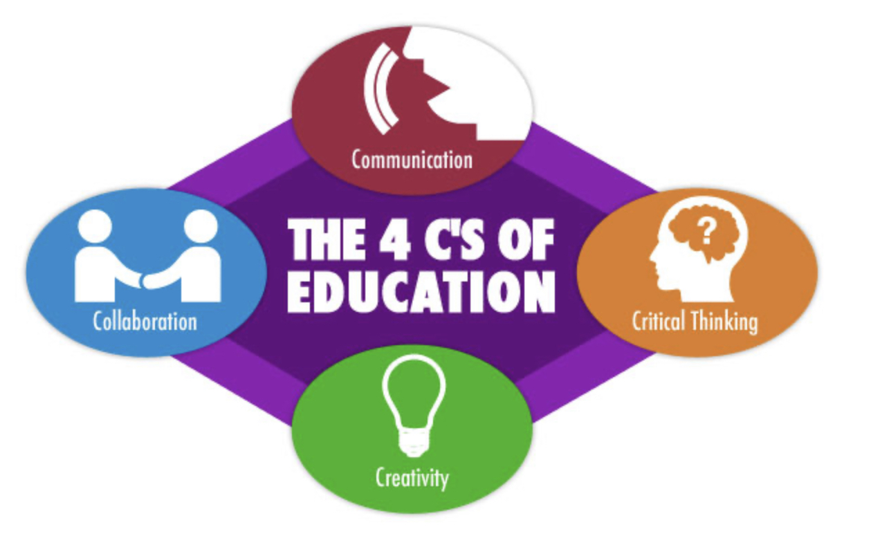
How are Foundations linked to 21st Century Skills?
Communication
Collaboration
Creativity
Critical Thinking
(Cheriedh 2016)
Notes:
Have teachers think about this and invite them to share.
Celebrate the fact that they are probably already planning for these skills unintentionally but now we want to begin to use foundations to plan intentionally!

Slide 16
Examples and Strategies: Using Foundations to intentionally plan for 21st Century Skills
Example #1:
APL-3S Use more complex language to share ideas and influence others during play. (Communication, Collaboration, Creativity, Social Skills, Flexibility)
Ideas for Strategies:
Pg. 37 #3 Foster cooperative play and learning groups. Stay involved in children’s play and learning groups to help children who may be less likely to join in because they don’t communicate as well as other children.
Take a minute to think about some strategies you can use to support, foster and encourage communication in your classroom.
(North Carolina Foundations Task Force.)
Notes:
Foundations align with 21st century skills. Using your Foundations book to plan will help you become intentional and see the alignment.
HPD-6i Use language to ask adults or peers specifically for the kind of help needed in a particular situation. (Communication, Collaboration & Initiative) Pg. #3
LDC-3g Ask specific questions to learn more about their world, understand tasks, and solve problems. (Communication & Critical Thinking ). Pg. 102 #15
CD- 1l Express knowledge gathered through their senses using play, art, language, and other forms of representation. (Communication, Creativity, Critical Thinking and Collaboration). Pg. 125 #5

Slide 17
Examples and Strategies: Using Foundations to intentionally plan for 21st Century Skills
Example #1:
ESD-4t Play and interact cooperatively with other children (work on projects together, exchange ideas). Collaboration, Creativity, Social Skills
Ideas for Strategies:
Pg.60 #8 Promote an atmosphere of cooperation instead of competition (e.g., introduce activities that require two or three children to work together).
Take a minute to think about some strategies you can use to support, foster and encourage collaboration in your classroom.
(North Carolina Foundations Task Force.)
Notes:
Foundations align with 21st century skills. Using your Foundations book to plan will help you become intentional and see the alignment.
HPD-6i Use language to ask adults or peers specifically for the kind of help needed in a particular situation. (Communication, Collaboration & Initiative) Pg. #3
LDC-3g Ask specific questions to learn more about their world, understand tasks, and solve problems. (Communication & Critical Thinking ). Pg. 102 #15
CD- 1l Express knowledge gathered through their senses using play, art, language, and other forms of representation. (Communication, Creativity, Critical Thinking and Collaboration). Pg. 125 #5

Slide 18

When thinking about 21st
Century Skills what does it look like in the eyes of a Child?
What does it look like in your classroom?
What are children doing?
What do they see?

Slide 19
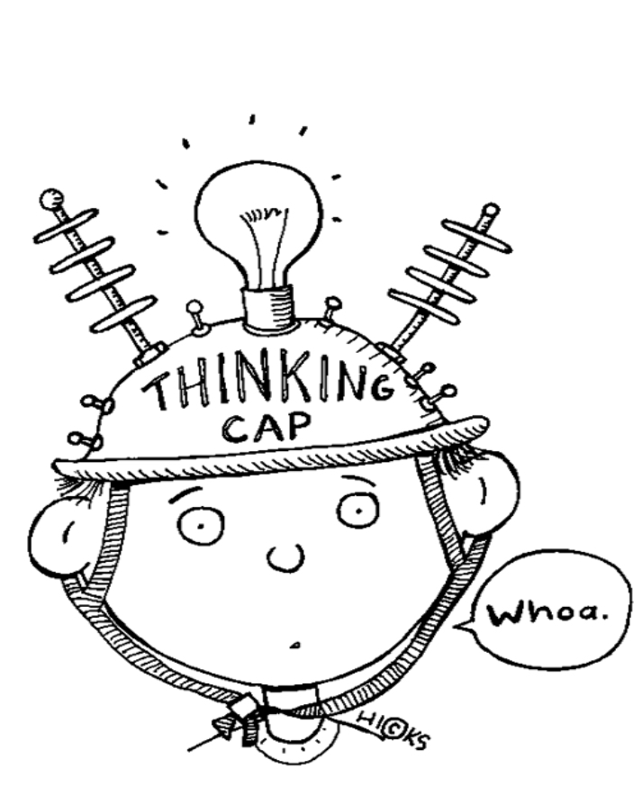
Critical Thinking
Information and Discovery
Interpretation and Analysis
Constructing Arguments
Problem Solving
What are children doing when they are working through problems? How do you support critical thinking in your classroom? What does it look like?
(Herschel 1996)

Slide 20

Communication
Effective Listening
Engaging in Conversation and Discussion
Using Digital Media
Communicating in Diverse Environments
When children are communicating, what does it look like? What are they doing?
How do you support and promote effective communication among children? What does it look like?
(Herschel 1996)

Slide 21

Collaboration
Leadership and Initiative
Cooperation
Flexibility
Responsibility and Productivity
Collaboration using Digital Media
Responsiveness and Constructive Feedback
When children are collaborating, what are they doing? Thinking? Saying?
How do you support them?
(Herschel 1996)

Slide 22

Creativity
Generating Ideas
Design and Refinement
Openness and Courage to Explore
Work Creatively with Others
Creative
What does children being creative look like in your classroom?
How do you support them?
(Herschel 1996)

Slide 23

Final Thoughts
When you think about 21st Century Skills, remember that it’s more than technology…
Think about how you can use Foundations to become more intentional in supporting 21st Century Learning Skills.
Think about how children feel, what they see and experience in a rich 21st Century Learning Environment.

Slide 24
References
Berry, M. (n.d.). Mentor Minute: Supporting Teachers As They Incorporate 21st Century Skill Building Opportunities (Part 1 of 2). Retrieved April 8, 2020, from https://ceme.uncc.edu/sites/ceme.uncc.edu/files/media/Mentor%20Minute%20-Jan.%202018.pdf
Cheriedh (11/03/2016). The 4 C’s for literacy instruction [4 C’s image] Retrieved from https://explorationsinliteracyblog.wordpress.com/2016/11/03/the-4cs-for-literacy-instruction/
Herschel, E.S., ed.(1996) The Block Book. 3rd ed. Washington, DC: NAEYC.
Mirra, N. (2018, April 24). What Do We Mean When We Talk About 21st Century Learning? Retrieved from https://clalliance.org/blog/mean-talk-21st-century-learning/
Murphy, L. (2014). Do Preschool Teachers Value Block Play? Paper presented at the Annual Conference of The Association for the Study of Play (TASP), Rochester, New York.
North Carolina Foundations Task Force. (2013). North Carolina foundations for early learning and development. Raleigh: Author.
Ross, D. (2017, September 20). Getting Smart: Helping Young Children Build 21st Century Skills. Retrieved April 8, 2020, from https://www.gettingsmart.com/2017/09/ten-strategies-to-help-children-build-21st-century-skills/
Shaw, R. (08/02/2017). Education Rick Shaw. Retrieved from https://educationrickshaw.com/2017/08/02/what-does-a-21st-century-classroom-look-sound-and-feel-like/
Spatula, N. (3/20/2017). [21st century rainbow circle image] Retrieved from http://nicks Paul.com/category/21st-century-skills
Wise Lindeman, K., & McKendry Anderson, E. (n.d.). Using Blocks to Develop 21st Century Skills. Retrieved April 8, 2020, from https://www.naeyc.org/resources/pubs/yc/mar2015/using-blocks
[woman writing plans image] retrieved from https://www.shutterstock.com/search/teachers+planning

